Slide 1

ADA Coordinators:
Emergency Management for
People With Disabilities
PACIFIC ADA CENTER
WEBINAR
APRIL 9, 2020
Robyn Gershon, MT, MHS, DrPH
Clinical Professor

Slide 2


Acknowledgements
Lewis Kraus, Co-Director Pacific ADA and Co-Investigator on study
Qi Zhi, Project Statistician
Patty Medina, Research Assistant

Slide 3
Acknowledgements: Expert Consultants
Ali Everett, Pasadena
Laney Davidson, Marin County
Kristen C. Darmody, Department of Health, Oregon

Slide 4
Overview of Today’s Webinar
Background Information
  ADA-Coordinators (ADA-C) role and responsibilities in disaster preparedness and response
  Review why it is important to know if ADA-C are prepared to meet their responsibilities under ADA
2019-20 Survey of ADA-C: FEMA Region 9
Applying these Findings
Notes:
Review the role of ADA Coordinators with respect to ensuring that All members of the community, including people living with a disability, are included in emergency management planning and response.
Find out how they are doing – where the gaps and challenges are-
The ultimate goal of this research is to Improve Preparedness and Response for People with Disabilities and Access and Functional Needs

Slide 5
Learning Objectives
To determine the roles and responsibilities of ADA Coordinators with respect to Emergency Management under the ADA
To identify barriers to their ability to influence other entities charged with ensuring ADA access with respect to Emergency Management
Discuss strategies for improvement

Slide 6
Responsibilities under Title II of the ADA
State and local governments must comply with Title II of the ADA in the emergency and disaster-related programs, services, and activities they provide.
Therefore, under Title II of the ADA, emergency programs, services, activities, and facilities must be accessible to people with disabilities.
This requirement applies to programs, services, and activities provided directly by state and local governments as well as those provided through third parties, such as the American Red Cross, private nonprofit organizations, and religious entities.
Notes:
https://www.ada.gov/pcatoolkit/chap7emergencymgmt.htm
One of the primary responsibilities of state and local governments is to protect residents and visitors from harm, including assistance in preparing for, responding to, and recovering from emergencies and disasters. State and local governments must comply with Title II of the ADA in the emergency- and disaster-related programs, services, and activities they provide. This requirement applies to programs, services, and activities provided directly by state and local governments as well as those provided through third parties, such as the American Red Cross, private nonprofit organizations, and religious entities. Under Title II of the ADA, emergency programs, services, activities, and facilities must be accessible to people with disabilities and generally may not use eligibility criteria that screen out or tend to screen out people with disabilities. The ADA also requires making reasonable modifications to policies, practices, and procedures when necessary to avoid discrimination against a person with a disability and taking the steps necessary to ensure effective communication with people with disabilities. The ADA generally does not require state or local emergency management programs to take actions that would fundamentally alter the nature of a program, service, or activity or impose undue financial and administrative burdens.

Slide 7
ADA Coordinators
Under Title II of the ADA, state and local governments with 50 or more employees must appoint an ADA Coordinator.
The ADA Coordinator implements and coordinates all ADA compliance activities.
Conducts self-evaluations and develops plans.
Monitors implementation of plans.
Handles requests for aides and services.
Notes:
Office of Emergency Management (OEM) or sometimes called Emergency Management Agency (EMA)
Many OEM or Emergency Management agency- as many have now been rebranded- were formerly the local offices of Civil Preparedness
and Defense
Authorities come from The development of a National Response Framework was mandated by the Homeland Security Act of 2002 and Homeland Security Presidential Directive-5. The plan was completed in January 2005 and revised after Hurricane Katrina. The NRF integrates the National Contingency Plan (NCP) and other national-level contingency plans

Slide 8
ADA Coordinators, continued
Provides information about accessible programs and services.
Serves as an ADA resource.
Receives and works to resolve complaints.
Works with officials and administrators to ensure new facilities or alterations are accessible.

Slide 9
Office of Emergency Management
Agency at the local or state level responsible for planning, responding, recovering from disaster events
They vary in size from very small one person operations to over 200 professionals with diverse backgrounds and areas of expertise, including individuals assigned from other City agencies
Notes:
ADA-Coordinators, as you might imagine, should work closely with OEM (aka as Emergency Management Agency (EMA) )
in order to help ensure the needs of PWD being addressed with respect to emergency preparedness and response. Many OEM or Emergency Management agency- as many have now been rebranded- were formerly the local offices of Civil Preparedness and Defense
Authorities come from The development of a National Response Framework was mandated by the Homeland Security Act of 2002 and Homeland Security Presidential Directive-5. The plan was completed in January 2005 and revised after Hurricane Katrina. The NRF integrates the National Contingency Plan (NCP) and other national-level contingency plans

Slide 10
Emergency Managers are responsible for:
Managing resources before, during, and after a major disaster or emergency
Conducting activities related to key components of emergency management
Coordinating with all partners in the emergency management process
Notes:
https://emilms.fema.gov/IS230c/FEM0104040text.htm
Managing resources before, during, and after a major emergency or disaster.
Taking inventory of personnel and material resources to include the private-sector sources that would be available in an emergency.
Identifying resource deficiencies and working with appropriate officials on measures to resolve them.
Developing and carrying out public awareness and education programs.
Conducting activities related to the key components of emergency management.
Coordinating the planning process and working cooperatively with organizations and government agencies.
Identifying and analyzing the potential impacts of hazards that threaten the jurisdiction.
Conducting threat/hazard and risk assessments.
Coordinating a review of all local emergency- and disaster-related authorities and recommending amendments, when necessary.
Coordinating with all partners in the emergency management process, to ensure they:
Are aware of potential threats to the community, including establishing a system to alert officials and the public in an emergency or disaster.
Participate in mitigation and prevention activities.
Plan for emergencies and disasters using an all-hazards approach, including establishing and maintaining networks of expert advisors and damage assessors for all hazards.
Operate effectively in emergency situations.
Conduct effective recovery operations after a disaster.
Are advised and informed about emergency management activities.

Slide 11
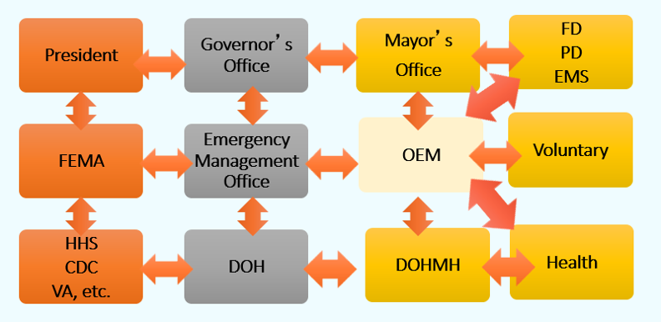
Federal, State, and Local Coordination in Disasters
Notes:
And just to refresh- all disasters start locally- then as needed, we coordinate at the state and then the federal level

Slide 12
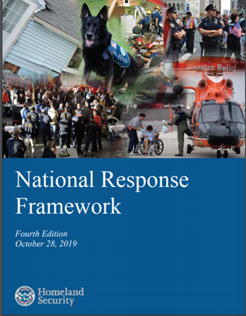
Includes the Authorities of all key entities including OEM
https://www.fema.gov/media-library-data/1582825590194-2f000855d442fc3c9f18547d1468990d/NRF_FINALApproved_508_2011028v1040.pdf
Notes:
The authority to have these responsibilities comes from The National Response Framework- https://www.fema.gov/media-library-data/1582825590194-2f000855d442fc3c9f18547d1468990d/NRF_FINALApproved_508_2011028v1040.pdf
it is the guide for the US responds to all types disasters- it is scalable, flexible, and adaptable- and builds upon the National Incident Management Systems or NIMS.
It includes emergency management authorities, as well as both policies and procedures at all local, state, federal levels, plus voluntary private sector organizations.
Also, here and elsewhere in govt documents concept of whole community- that is- that everyone has a responsibility for preparedness- including the general public. FEMA now urges people to be prepared before help arrives for 72hrs, for healthcare facilities this is now 96 hrs

Slide 13
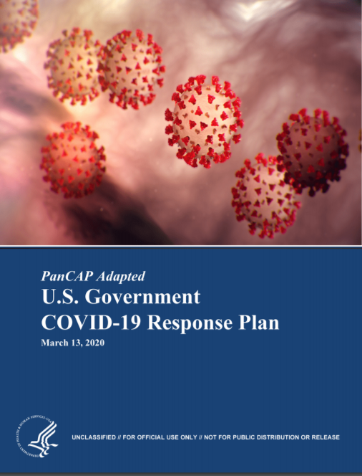
This latest Plan
includes the Authorities of all key entities for COVID-19
https://int.nyt.com/data/documenthelper/6819-covid-19-response-plan/d367f758bec47cad361f/optimized/full.pdf#page=1
Notes:
Specific Plans are also prepared by the govt- which all entities must adhere to
March 13, 2020 https://int.nyt.com/data/documenthelper/6819-covid-19-response-plan/d367f758bec47cad361f/optimized/full.pdf#page=1

Slide 14
In Emergency Management, people with disabilities are considered to have access and functional needs
 Here are the inclusion criteria for access and functional needs:
  Physical, developmental or intellectual disabilities (including visual impairments, deaf or hard of hearing, mental health conditions, physical disabilities, cognitive disabilities)
  Chronic conditions or injuries
  Limited English proficiency
  Older adults
  Children
  Low income, homeless and/or transportation disadvantaged
  Pregnant women
Notes:
LK

Slide 15
Why is it Important to Know how well ADA-C are Doing in Terms of Meeting the Needs of People with Disabilities with Respect to Emergency Management?

Slide 16
Major and Converging Trends are Increasing Risk of Disasters

Slide 17

Countries with the Most Major Natural Disasters in 2017
# of natural disasters in 2017, by country
Note: Worldwide
Further information regarding this statistic can be found on page 8.
Source(s): CRED; ID 269652
2
Notes:
The US is one of the top 5 nations in the world with the Highest frequency and severity of disaster events

Slide 18
Increasing Concern: Climatological and Bioevent Disasters
Risk factors
Human population growth
Climate change
Increased globalization
Increased urbanization and coastal development
Land-use and population practices that facilitates zoonotic transmission
Increased vector-borne diseases
Substandard public health and health care systems
Declining vaccination rates
Overuse of antibiotics
Mass migration/displacement of refugees, many in squalid refugee camps
31
Notes:
Growth- we now have 7.4 billion people in the world- by 2050- it will be about 11 Billion- a 40% growth. In the US we will grow from 330 M to about 400 M about a 36% increase. This population growth is leading to increased encroachment into wildlife areas
We also know that people have low levels of willingness to comply with either community or individual level public health control measures to stem outbreaks- for ex while 75% of people think quarantine of people may be needed- less than half that would be willing themselves to be quarantine. The only acceptable outbreak control measure on a list of about a dozen- was increased handwashing

Slide 19
And.. especially now… Readily and Rapidly spread novel pathogens
Readily spread novel pathogens

Slide 20
Emerging Pathogens
HIV
Multidrug Resistant TB
(MDR-TB)
West Nile Virus
Hanta
Virus
Zika
Virus
H1NI
MERS
Chikungunya Virus
Ebola
Severe Acute Respiratory Syndrome (SARS)
COVID-19
Notes:
In the past few decades alone, more than 90 emerging pathogens have been identified, including these listed here
We also have a threat from reemerging diseases such as measles
https://wwwnc.cdc.gov/eid/article/1/1/95-0102_article
https://www.nature.com/articles/nature02759

Slide 21
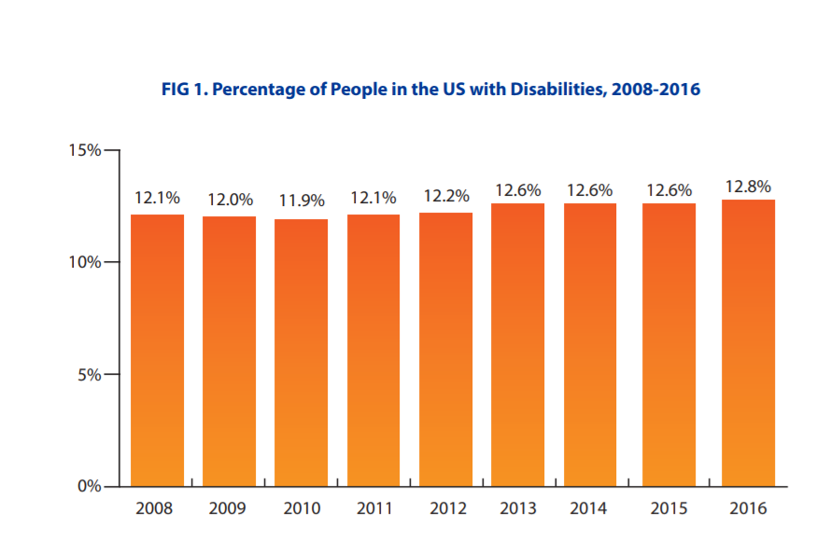
Population of People Living with a Disability is large… and growing
Notes:
Also important to know….
Depending on the source of the data- there are an estimated 55-60M Americans living with a disability.

Slide 22
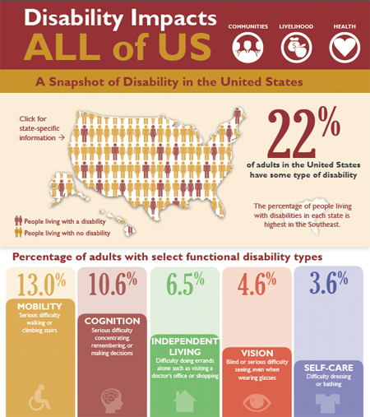
Population of People Living with a Disability is large… and growing
Notes:
The graphic is from CDC: https://www.cdc.gov/media/releases/2015/p0730-US-disability.html
Roughly one in 4 or 5
In 2016 CDC Published a report that was based on the 2016 Behavioral Risk Factor Surveillance System (BRFSS) data. They found that one in four noninstitutionalized U.S. adults (25.7%, representing an estimated 61.4 million persons) reported any disability.
https://www.cdc.gov/mmwr/volumes/67/wr/mm6732a3.htm?s_cid=mm6732a3_w&c_cid=journal_search_promotion_2018#F1_down

Slide 23
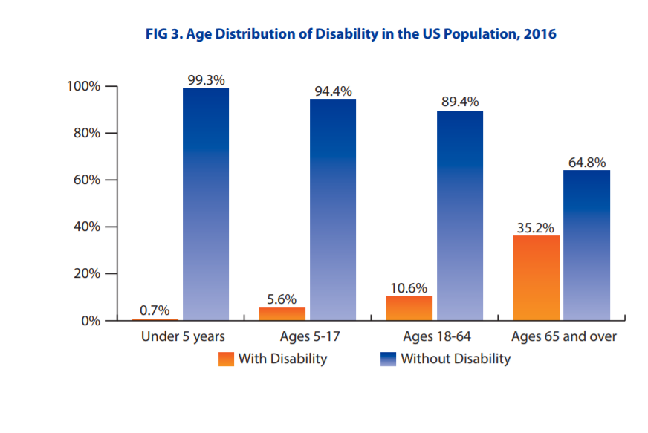
Increasingly…. The US Population is Aging
Notes:
Increasingly, the population is aging- from 46M people 65 yrs and older we are projected to have 98M by 2060-
People over 65 now represent 15% of the population- by 2060 that will increase to 24%
Older adults are generally at risk for decreased physical functioning- esp mobility- although this is not always the case-

Slide 24
People with Disabilities are not Generally Well-Prepared for Disasters
2011 Gershon/Kraus Study
Convenience sample of 252 disabled people receiving personal assistance
7-item preparedness measure:
mean score was 2.3 (range, 0-7)
  32% had emergency supplies available at home
  29% could communicate with PA in emergency
  26% had back-up PA plans
Notes:
Abt a 30% score So, its important to know if ADA Coordinators are ready to meet the needs of PWD in their community- with respect to disaster preparedness and response – including people with a disability, not only because the population at risk is large, and growing, and because the number and severity of disaster events is also increasing,
But..,. Very importantly, because every indication we have indicates that people are not ready- including people living with a disability
Information on the emergency preparedness planning of people with disabilities is VERY limited
We have some data from a 2011 study conducted by Gershon and Kraus on a convenience sample of disabled people WHO also had personal assistants- we were especially interested to find out the role the PA played with respect to preparedness.
We measured preparedness using seven items: having a personal emergency plan; an evacuation plan; an easy-to-carry go bag with critical items, such as medications, cell phone, flashlight, etc.; having emergency supplies at home, such as extra food, batteries, supplies and equipment; having a communications plan for contacting the personal assistant; having an emergency contact list; and having a back-up plan for personal assistance help.
Additional items determined whether or not the respondent had tested their emergency plan, if they shared their plan with all or some of their assistants, and an open- ended question was included that asked them to provide the reasons for not sharing their plan with their personal assistant. We also asked about prior disaster experiences.

Slide 25
2014 Study- Preparedness Plan Results
47% had emergency plan
  2/3 of them had included PA in plan creation
  But 4% involved only some, 10% with none
      “My PA will be busy tending to the needs of their own
      family members”
      “The PA is just not that dependable”
      “I might not be with my PA when an emergency occurs.”
Notes:
Nearly half of the sample (n=120, 47%) reported that they had an emergency plan.
Of these, 66% indicated that they had involved their PA in its development, with 4.0% indicating that they shared their plan with only some of their Pas, 10% had NOT shared the plan with their PAs. Common reasons given for not sharing their plan with PAs included: “My PA will be busy tending to the needs of their own family members, “The PA is just not that dependable”, “Experience tells me I can’t count of them”, “I have a new PA and they did not help me develop the plan”, and “I might not be with my PA when an emergency occurs.” Of those reporting a plan, 57.5% (n=69) reported that they had actually tested their ability to use the plan. Involvement of the PAs in the emergency plan was strongly associated with emergency preparedness; but sample size was small and results should be interpreted with caution.
SCORE would be 33%
35% had an evacuation plan, 28% had a go-bag ready, 32% had emergency supplies available, 29% had a way to communicate with their PA in case of an emergency; they planned to communicate using cellphones (28%), text messages (13%), emails (146%), online social networks (3%), two-way radio (0.8%) and ham radio (0.4%). In terms of having an emergency contacts list, 35% had such a list.
With regards to the planning for an alternative source of personal assistance in case their regular PA would not be available to assist them during an emergency, 26% reported that they had made alternative back-up plans. For those participants indicating an alternative back-up plan, 77% would rely on family members, 51% would rely on friends, 36% would rely on neighbors, 1% on co-workers. A very small proportion, 4% reported that they intended to hire another PA “on the spot.” A low proportion, 20% thought that the agency providing for their care would allow their PA to accompany them in order to continue to provide services if they were evacuated to another area (such as a shelter or a hotel).
On the 7-item emergency preparedness scale, the mean score was 2.3 (S.D.=2.74), the median was 0.0, the mode was 0.0, and the range was 0-7. The Cronbach alpha was .93 (95% CI .916- 942), indicating a good internal consistency for this scale.

Slide 26
2014 Study on Disaster Preparedness of Elderly Home Care Recipients in San Francisco, N=50
Mean score of 4.74 on a 13- item preparedness checklist
56% had extra meds on hand
44% had back-up power for powered equipment they use
38% had made back-up plans for their caregiver(s)
26% had plans for transportation to shelters
19% had someone in building that could help them evacuate if elevator not working
70% had extra supplies on hand for their pets
Notes:
We know from a more recent study I conducted that vulnerable elderly people (who are also often disabled) are NOT ready
and importantly, the size of the elderly population is growing- while people 65 and over represent 15% of today’s population, by 2060 they will represent about 25% of total population.
This was a qualitative theory generating study of the factors that influence preparedness in elderly-
Data were collected using a semi-structured interview from 50 elderly home care patients- all receiving home care

Slide 27
Barriers To Personal Preparedness
Lack of self-efficacy (Lack of resources, No family or friends nearby)
  “ I can’t do those preparedness things; the government should help me.”
Risk awareness was high, but relevance of risk to them was low:
“I’ve lived a full life, actually, I’m ready to go…”
Sense of community was low
“They don’t really care. I’ve been sick right in here, and no one came and knocked on the door…that’s just the way it is.”
Lack of Trust in Authorities
“There’s going to be a big mess-up between the police and firemen”
“ You can’t depend on the police, fire, the army, or national guard. You can’t depend on the city or county.”
Notes:
Self- efficacy was low - many felt they could not do much to help themselves
80% had household incomes of 20K or less. No material or social support resources in many cases
Wanted govt, first responders, clergy, strangers, anyone to help them
Risk awareness was high but fatalism led to lack of preparedness

Slide 28
2018 FEMA Report
“Preparedness in America”
21% of the US sample (N=2,000) WERE NOT planning to do any disaster preparation.
46% - Preparedness was not at all on “their radar.”
Cost and not knowing how to prepare were barriers.
However, people who thought they were at risk, thought they could do something to prepare, thought preparing would help them, and felt confident in their ability to prepare WERE MORE LIKELY to be prepared.
  Only small differences were noted for participants with and without a disability.
Notes:
Finally we have information on the general population and how well they are prepared from FEMA National Preparedness Surveys
2014 FEMA National Preparedness Survey – that people in general are not ready
**Denial is a maladaptive response to fear
FEMA report: https://www.fema.gov/media-library-data/1409688068371-d71247cabc52a55de78305a4462d0e1a/2014_NPR_FINAL_082914_508v11.pdf

Slide 29
To Recap-Why is it important to know if ADA Coordinators are ready to help ensure needs of PWD are met with respect to ADA ….
Disasters are increasing in frequency and severity
Vulnerable Population is large and growing
Individual-level preparedness is low
And……

Slide 30
People with Disabilities are Disproportionately Affected by Disaster Events
Latest US data suggest a 30-50% increased risk of disaster-related fatality among people with disabilities.
  1/3 of Hurricane Maria fatalities are believed to have resulted from “interrupted care”
Covid-19 is exposing potential vulnerabilities regarding accessibility to limited resources such as ventilators and ability to navigate social/physical distancing policies

Slide 31
Study Methods
Study conducted in late winter 2019-2020
Input from key stakeholders (Ali Everett, Laney Davidson, Kristen Darmody).
Confidential web-based survey of ADA Coordinators from FEMA Region 9, (California, Nevada, Arizona, Hawaii, and the Pacific Islands). Multi-modal recruitment
Questions on role, responsibilities, influence, training, knowledge
Final survey had 36 items and took about 15-20mins to complete
Respondents (N=131)
Notes:
Marci Roth
Erica Jones
June Kailes
Heavy focus on items from the ADA checklist and other available materials
The sample frame for this group (OEM) is not well delineated

Slide 32
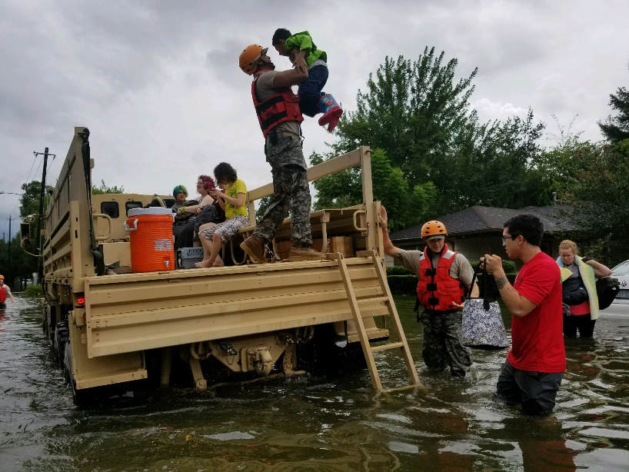
Study Results
Most respondents came from California, followed by Arizona
27% had an estimated jurisdiction of > 1M residents; 20% had 100-500K and 50K-100K
About 40% reported at least one major disaster event in last 5 years.
18% know approx. # of
PWD in their jurisdiction

Slide 33
Demographics
56% female
35% have a disability
More than half are 50yrs and older
86% have college degree or higher
30% earn less than $50K a year; 20% each > 90K per year

Slide 34
Employment Info
44% work full-time as ADA Coordinator
More than half have worked as ADA Coordinator for less than 3yrs
  20% less than a year
Most are based out of either ADA Coordinators Office or Public Works
Reporting to: City Manager or their Asst; Director of Planning; Emergency Mgt.
Notes:
Emergency Management (including Sheriff’s Office)
City Manager or City Clerk Office
Human Resources and Equal Opportunity Offices
Risk Management Office
Health and Human Services
General Admin
Non-profit (including Red Cross)
Treasury & Finance Office
Senior Services or Aging Dept
Dept of Corrections
City Manager
Deputy or Assistant City Manager
Director of Planning and Development
County or Field Administrator
Office of EO Administrator

Slide 35
Employment Info
32% held an ADA related job prior to this job
28% previously held an emergency planning type job
A majority- 69% hold other job titles/have other job duties
More than half (56%) work alone in their role
Less than half (43%) have back up to their emergency management duties if they are not at work
70% spend less than 10% of their job on ensuring ADA compliance in Emergency Management
Notes:
50% thought they really needed to spend 20% or more of their time on it- and 10% thought they should spend 65% or more of their time on it
Important to note:
On our OEM survey- only 36% said they had access to ADA-C in their jurisdiction!!!

Slide 36
Participants Response to Question:
What Qualifications/Special Training are Needed for this Job?
26% NONE
19% Complete an ADA Basics course
11% Complete 40 training credits for
Certification program
7% I Don’t know
Notes:
Other ADA Responses: 7% : “I honestly don’t know;” “I have no idea;” “I served on a recovery committee after Katrina”

Slide 37
Emergency Management Role how do they ensure access
56% are currently responsible for ensuring ADA access with respect to Emergency Management
  39% provide technical assistance
  34% do it themselves directly
  28% make sure it is in Plan
  24% provide technical assistance
  24% serve on EOC
  13% I do not ensure ADA access
Notes:
Serve on EOC Later on in survey we repeat this question in another section- here the response was 35% vs 24% here

Slide 38
Emergency Management Responsibilities
Who is Responsible for Assuring Access?
  56% Stated: “I am Responsible for ensuring access”
  Later on in survey we repeated this question; here is what they then stated:
45% OEM
11% First Responders
9% ADA Coordinator
8% No One
Notes:
After seeing what this job SHOULD ENTAIL, they changed their minds about whether or not they truly WERE RESPONSIBLE HOWEVER!!!
Although a Majority said they were responsible for ensuring ADA Access with respect to emergency management- they fall way short on specific responsibilities that this entail.

Slide 39
Capabilities with respect to ADA Requirements for Emergency Management
22% feel knowledgeable
16% feel influential
36% feel that they have had adequate training
These are highly correlated:
ADA-C who feel they have had adequate knowledge are significantly more likely to feel influential and had adequate training (P<.01)
Notes:
Their ability to meet their responsibilities is dependent on these questions related to
Knowledgeable: regarding all ADA requirements to ensure equal access with respect to Emergency Management Planning and Response.
Influence: I am able to influence other entities (e.g., Office of Emergency Management) to ensure ADA access with respect to Emergency Management Planning and Response.
Adequate training: I have had adequate training to ensure equal access with respect to Emergency Management Planning and Response.

Slide 40
What are they Specifically Responsible For?
Reading the EO Plan to ensure ADA Compliance
  ADA Coordinator (27%); Not sure who is (26%)
Writing and updating Emergency operations Plan
  ADA Coordinator (12%); Not sure who is (12%)
Proving oversight to ensure ADA
  ADA Coordinator (16%); Not sure who is (15%)
Involving people w disabilities to identify needs
  ADA Coordinator (23%); Not sure who is (18%)
Notes:
All of these items are with respect to EM responsibilities under ADA
They fall way short on specific responsibilities that this entails- PLUS they are UNSURE about who exactly is responsible
Furthermore- Very low % are responsible- is almost same as % saying they do not know who is!!!

Slide 41
Specific Responsibilities
Ensuring All Communicationa are accessible
    ADA Coordinator (11%); Not sure who is (11%)
Ensuring accessible transportation
    ADA Coordinator (9%); Not sure who is (14%)
Ensuring shelters are accessible
    ADA Coordinator (13%); Not sure who is (16%)
Involving people w disabilities in all drills and exercises
    ADA Coordinator (15%); Not sure who is (18%)
Notes:
All of these are with respect to EM responsibilities under ADA

Slide 42
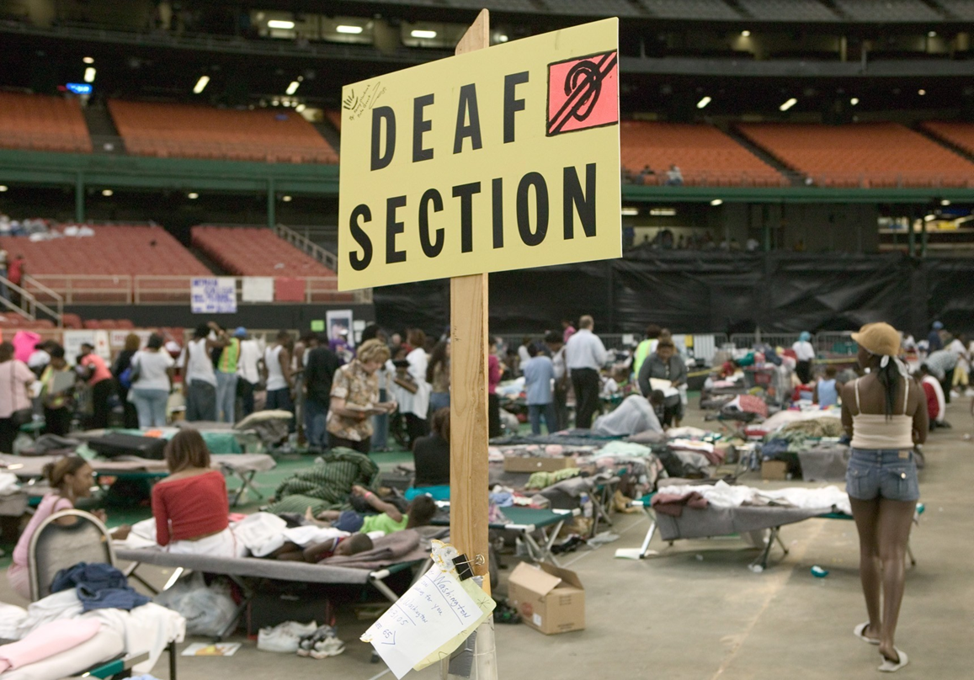
Shelter Operations

Slide 43
Specific Responsibilities – at Shelters
Ensuring refrigerators for meds available
  ADA Coordinator (6%); Not sure who is (20%)
Ensuring personal assistants access to shelters
  ADA Coordinator (5%); Not sure who is (15%)
Ensuring access to Oxygen at shelters
  ADA Coordinator (4%); Not sure who is (16%)
Ensuring back-up power
  ADA Coordinator (5%); Not sure who is (13%)
Ensuring access to service animals
  ADA Coordinator (9%); Not sure who is (15%)
Ensuring accessible communications at shelters
        ADA Coordinator (9%); Not sure who is (12%)

Slide 44
Specific Responsibilities
Ensuring accessible transportation
  ADA Coordinator (9%); Not sure who is (14%)
Ensuring shelters are accessible
  ADA Coordinator (13%); Not sure who is (16%)
Involving people w disabilities in all drills and exercises
  ADA Coordinator (15%); Not sure who is (18%)

Slide 45
Specific Responsibilities
Ensuring PWD are not sent to Medical shelters, unless indicated
        ADA Coordinator (18%); Not sure who is (16%)
Ensuring PWD not turned away from shelters if Personal Asst not with them
        ADA Coordinator (8%); Not sure who is (15%)

Slide 46
Specific Responsibilities - Recovery
Providing input to After-Action reports
        ADA Coordinator (28%); Not sure who is (13%)
Involving PWD in After-Action Reports
        ADA Coordinator (24%); Not sure who is (15%)
Helping to change policies based on results of After-Action Reports
              ADA Coordinator (31%); Not sure who is (14%)

Slide 47
What Limits Their Effectiveness??
LACK of time!
Lack of awareness
Lack of resources
Lack of staff (and competent staff)
Lack of knowledge and training
Lack of authority in my role as ADA Coordinator
Changes in administration makes it hard to develop relationships

Slide 48
What Would Increase their Effectiveness??
More TRAINING!!
More support from other entities
More involvement of OEM More collaboration (Red Cross, OEM)
More coordination w disability orgs.
Stronger work relationships
Supportive work environments
Notes:
More support from other entities including City Mgt, Dept Heads, County Commissioners, OEM

Slide 49
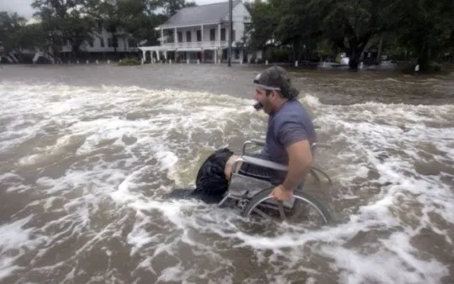
What Specialized Training is Needed to do these Jobs?
ADA Coordinator
None: 26%
“ADA Basics” Course: 19%
40 hr ADA Certification Program: 11%
OEM
None: 17%
AEM Certificate: 11%
CEM Certificate: 23%
State Certificate: 34%

Slide 50
Conclusion
Underutilization of specialized skills ADA-C can bring to emergency management was evident
There was interest in improvement and having a greater role - especially want more info on ADA compliance with respect to emergency management
Disability expertise and knowledge of ADA is needed at ALL levels of disaster response
Notes:
Preparedness, response and recovery phases in particular

Slide 51
Preliminary Recommendations
Professionalizing their role in emergency management
Clarifying their role as part of the team in emergency management
Providing both standardized tools and resources…
… as well as just in time tools they can apply- right now- to ANY Disaster Event
Notes:
Based on these data we can make some recommendations

Slide 52

Thank you!!
Robyn Gershon
rg184@nyu.edu
Lewis Kraus
lewisk@adapacific.org

Slide 53

Resources
Pacific ADA Center
 www.adapacific.org/emergency
 Webinars - ADA National Network/FEMA Webinar Series: Emergency Management and Preparedness-Inclusion of Persons with Disabilities (www.adapresentations.org)
Notes:
LK

Slide 54
Resources
Pacific ADA Center
 www.adapacific.org/emergency
 Checklists and toolkits (Personal)
  Bedside Emergency Supplies Checklist
  Car Emergency Supplies Kit Checklist
  Carry On You Emergency Supplies Kit Checklist
  Emergency Contact List
  Emergency Food and Water
  Emergency Power Planning
  Emergency Supplies Kits
  Keep Your Important Documents Safe from a Disaster
Notes:
LK

Slide 55
Resources
Pacific ADA Center
 www.adapacific.org/emergency
 Checklists and toolkits (Personal)
  Evacuation Transportation Planning Tips
  Grab and Go Emergency Supplies Kit Checklist
  Grab and Go Emergency Supplies Kit with Daily Use Items Checklist
  Home Emergency Supplies Kit Checklist
 Checklists and toolkits (Agencies)
  Maintaining Site Accessibility Checklist
  Press Conference Checklist
Notes:
LK

Slide 56
Pacific ADA Center
Resource Page on COVID -19
www.adapacific.org/COVID19

Slide 57
Bibliography
 FEMA Guidance for Functional Needs Support Services
https://www.fema.gov/media-library-data/20130726-1831-250457316/fnss_guidance.pdf
 ADA Web Courses
https://www.adapacific.org/training-ada-basic-web-course
 Annual Disability Statistics Compendium
https://disabilitycompendium.org/
 “Emergency Preparedness in a Sample of Persons with Disabilities” by Gershon et al.
https://www.ncbi.nlm.nih.gov/pubmed/23716372
Notes:
LK

